Slide 1
Binary Logistic Regression
Odds ratio
Review of Chi-square
Characteristics of logistic regression
Hierarchical logistic regression table

Slide 2
1. Odds Ratio
Defendant’s Victim’s Death Penalty % Yes
Race Race Yes No
W W 19 132 0.126
B 0 9 0.000
B W 11 52 0.175
B 6 97 0.058

Slide 3
Defendant’s Victim’s Death Penalty
Race Race Yes No
W W 19 (1, 1) 132 (1,2)
B 0 (2,1) 9 (2,2)
B W 11 (3,1) 52 (3,2)
B 6 (4,1) 97 (4,2)

Slide 4
When a victim is white, what it a likelihood of white defendant to receive death penalty as opposed to black defendant?
[f(1,1)/f(1,2)] / [f(3,1)/f(3,2))]=[19/132]/[11/52]=0.678
Take inverse to interpret OR when it is <1.0
When a victim is white, odds ratio of black to receive death penalty as opposed to white is;
1/0.678=1.47
When a victim is white, black is 1.47 times more likely than white to receive death penalty.

Slide 5
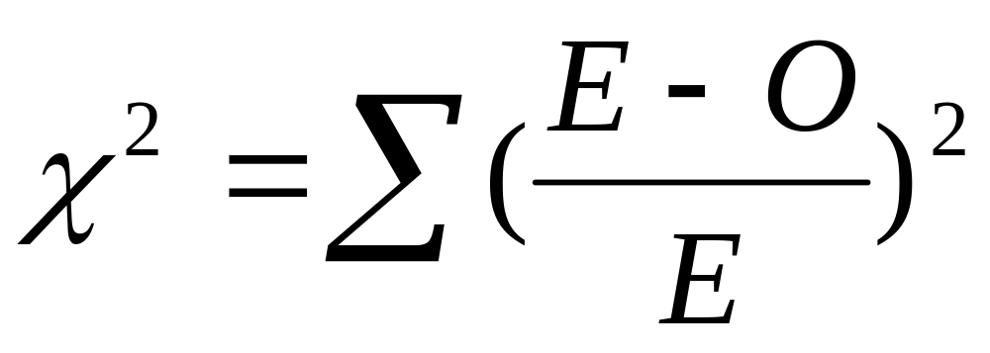
2. Chi-square

Slide 6
a) To test a contingency table
Two variables are categorical variables.
e.g. association between social class and
political affiliation
association between sex and whether
or not they voted

Slide 7
H0: There is no association between two variables.
If chi-square is large with small p-value, then you reject H0.

Slide 8
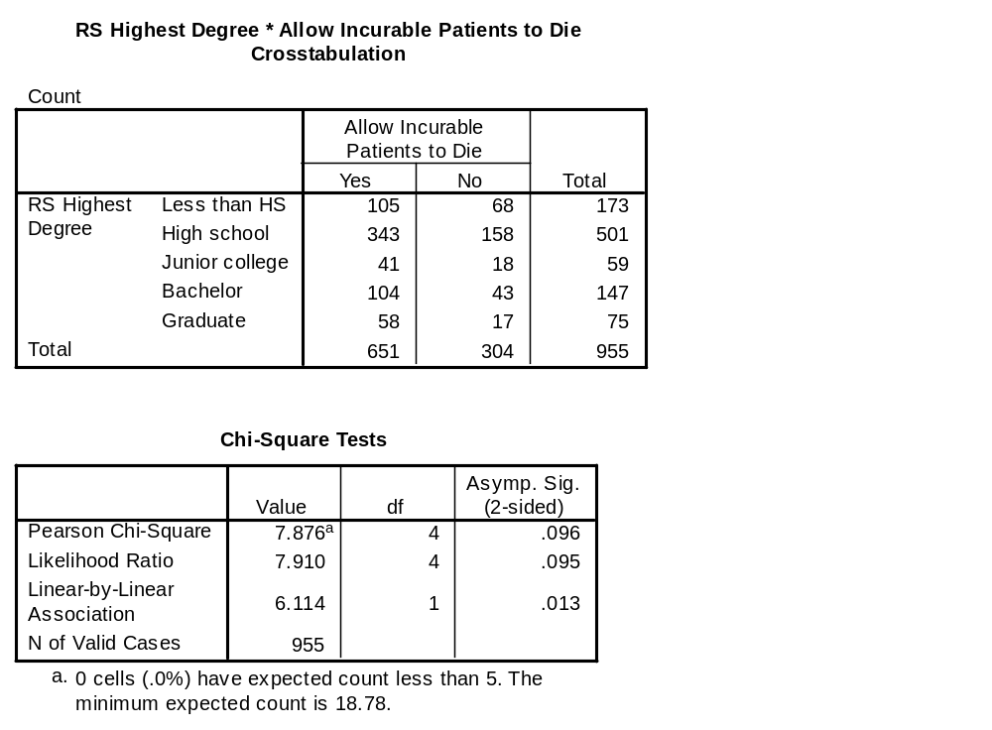

Slide 9
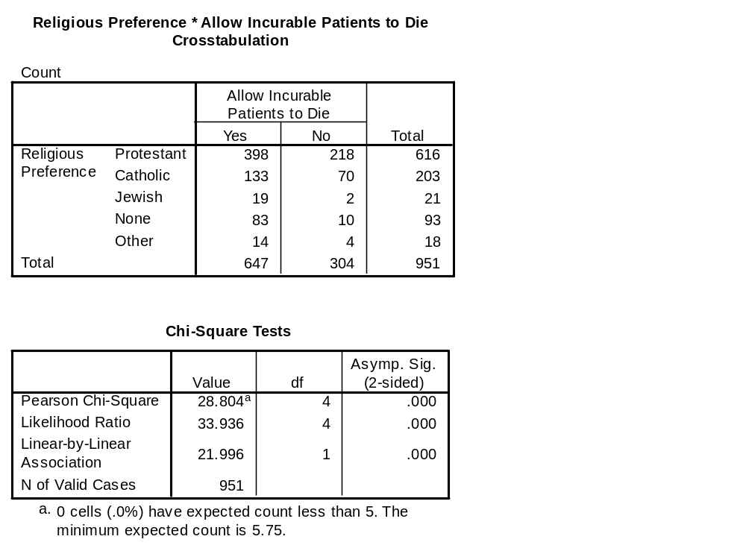

Slide 10
b) To test goodness-of-fit of data
H0: There is equal proportion of males and female in the data.
If chi-square is small and p-value is large, you do not reject H0.

Slide 11
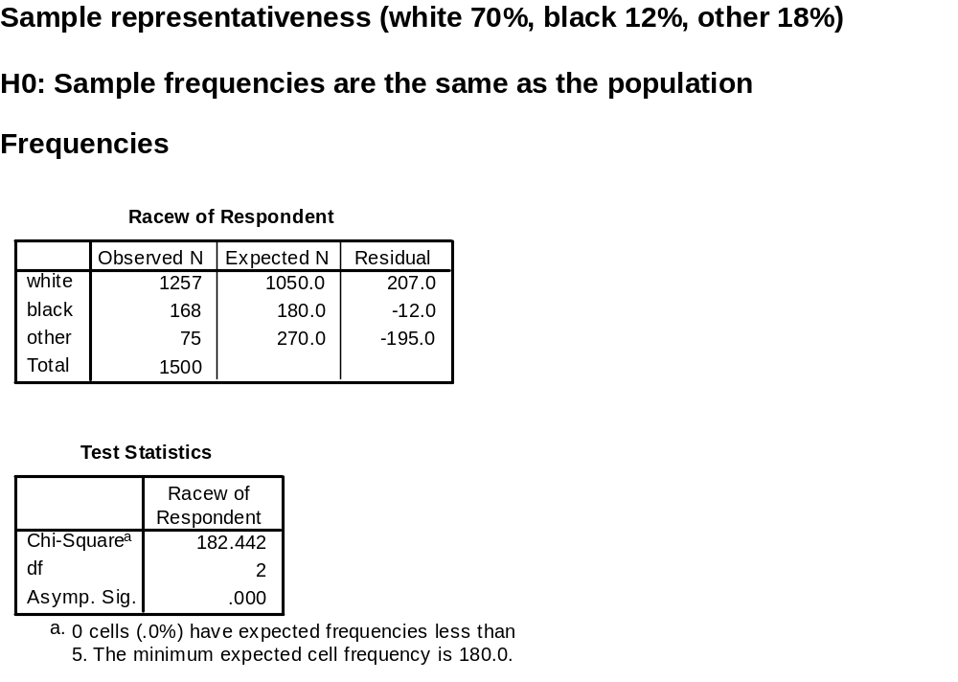

Slide 12
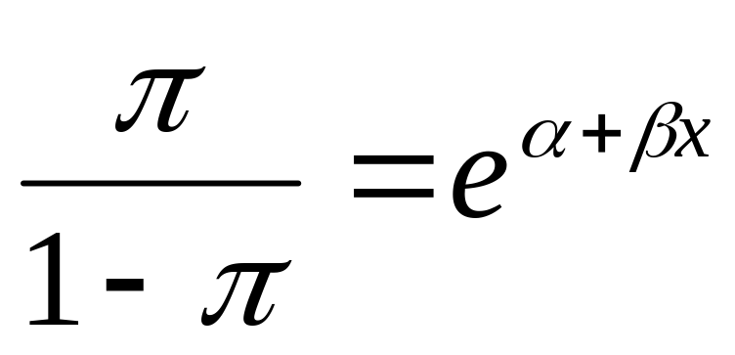
3. Characteristics of Logistic Regression
DV is dichotomous (0, 1)
Equation

Slide 13
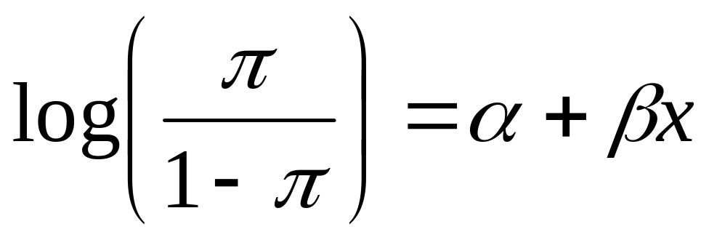
Logistic transformation

Slide 14
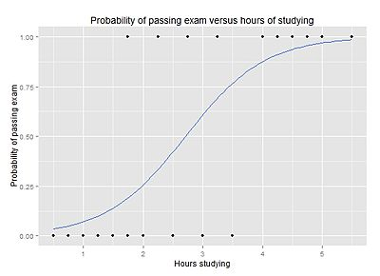
From Wikimedia Commons, the free media repository
Michaelg2015

Slide 15
When the coefficient >0, probability increases as the value of IV increases.
When the coefficient <0, probability decreases as the value of IV increases.

Slide 16
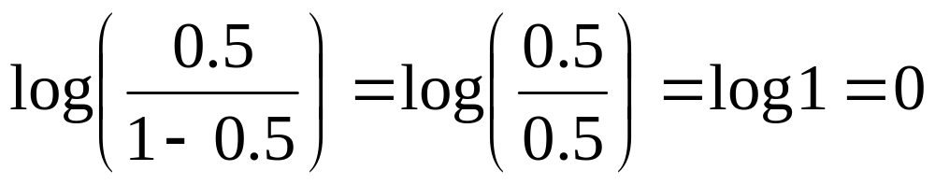
Probability 0.5 corresponds to a logit of 0.

Slide 17
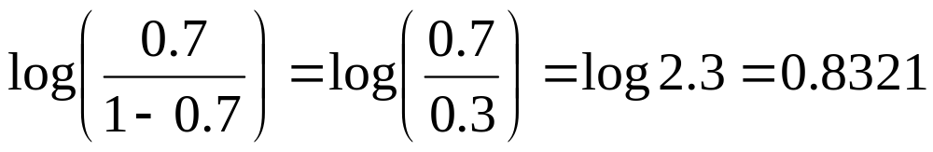
Probability >0.5 corresponds to a positive logit
e.g. p=0.7

Slide 18
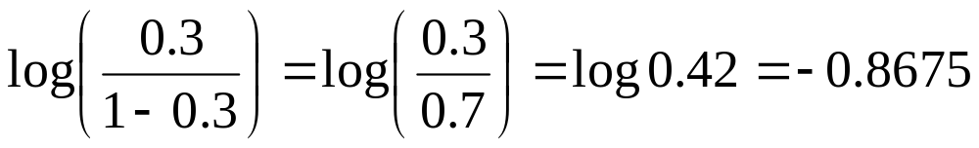
Probability <0.5 corresponds to a negative logit.
e.g. p=0.3

Slide 19
If a coefficient is 0, the probability does not change as the value of IV changes.
Coefficient cannot be interpreted as a simple slope.

Slide 20
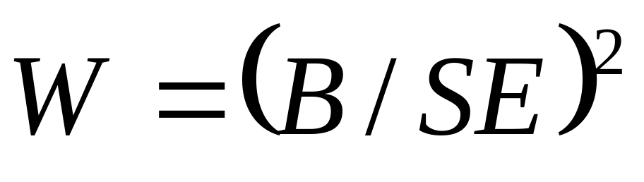
Model fit is determined by Omnibus test and Hosmer-Lemeshow test.
Significance of IV is determined by Wald Scale

Slide 21
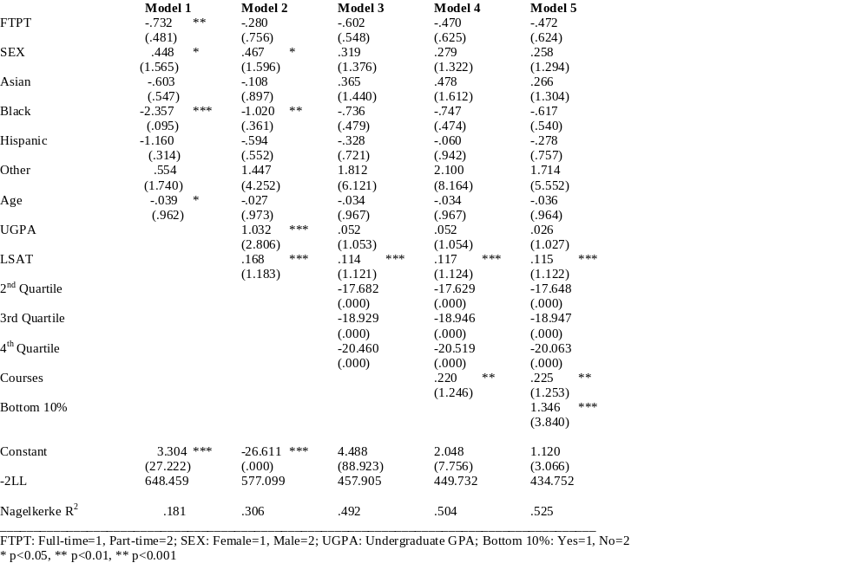
Table 3 Hierarchical Logistic Regression of Bar Exam Passing (Exp B)

Slide 22
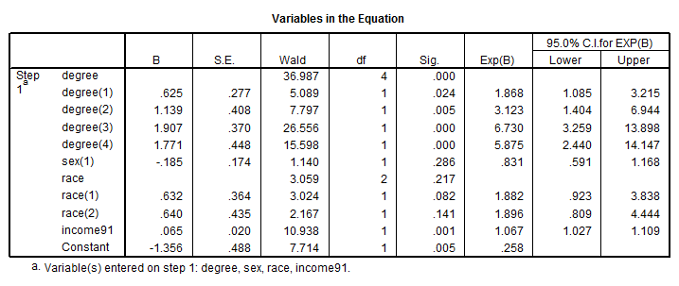
Coefficient table in SPSS output file (see the word file for detailed information)

Slide 23

Questions?

